Slide 1
EduCare
A Smart Unified Educational Platform

Slide 2
Contents
00.
Introduction
02.
Implementation
Problem Statement
Proposed Solution
Programming Languages, Tools, API
Main functionality
Features
02.
Testing
03.
Conclusion and future work
Testing Approach
Testing Tools
Testing Features
Testing Samples
Conclusions
Growth Areas
Notes:
Organized in the same way the documentation is organized

Slide 3
Introduction

Slide 4
Online Educational Industry
1000+
+1.1B
+$199B
+$602B
Platforms
Students (online)
Value Now
Value By 2030
Notes:
Give some numbers on the industry to showcase its importance and that there is an investment in the field we are working on

Slide 5
Empower learners of all ages to reach their full potential through accessible, engaging, and effective educational experiences
Vision
Unified educational platform that provides the necessary modern tools to be able to collaborate, organize, and search for knowledge with ease
Mission
Notes:
Provide a mission and vision to the platform to underline the proposed solution

Slide 6
Problem Statement
00.
01.
Organize assets, course, and user tasks
Too many platforms and Overwhelming Resource
Notes:
Provide some examples on the overwhelming resource and platforms
HIgher education and work is a smaller gap than higher education and schools
Low investment due to lack of importance and resources
Public tooling gaps and flaws

Slide 7



Proposed Solution
Secure, Reliable, and Efficient Unified Platform
Tools for sharing and organizing
Asset Upload organizing suggestions

Slide 8
Implementation

Slide 9
Programming Languages, Tools, API
00
01
Front-End
Back-End
Notes:
Open source since education should not be a closed off technology it should be for everyone and from everyone
Enterprise platform for fully managed solution

Slide 10


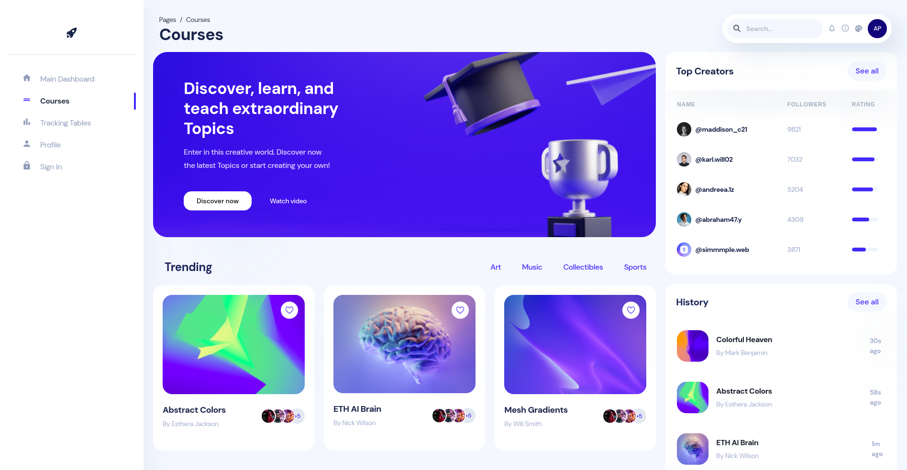
Modern Platform
Build using React
Reactive Dashboard
Well-Designed UI and Good User Experience
Notes:
Talk about why the interfaces are different (due to customization for enterprise use and custom courses)

Slide 11
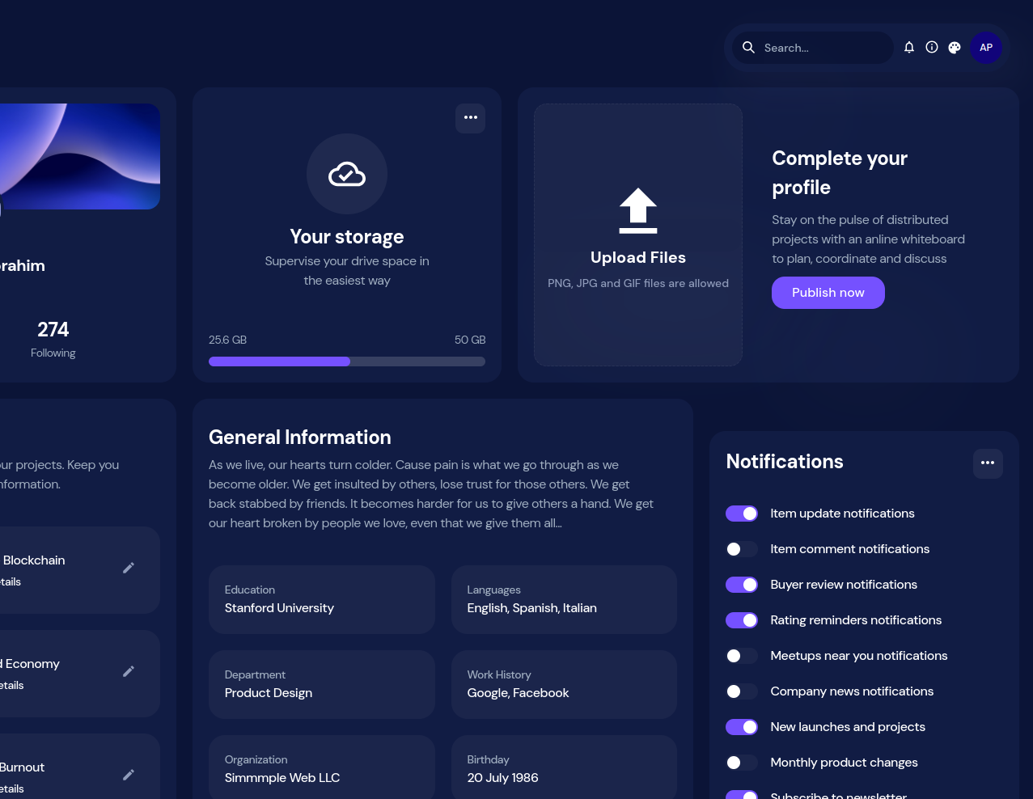

Resources and Asset Management
Upload any type of files.
Suggest where the file should be stored, in which folder.
Provide a large quota for each user.

Slide 12

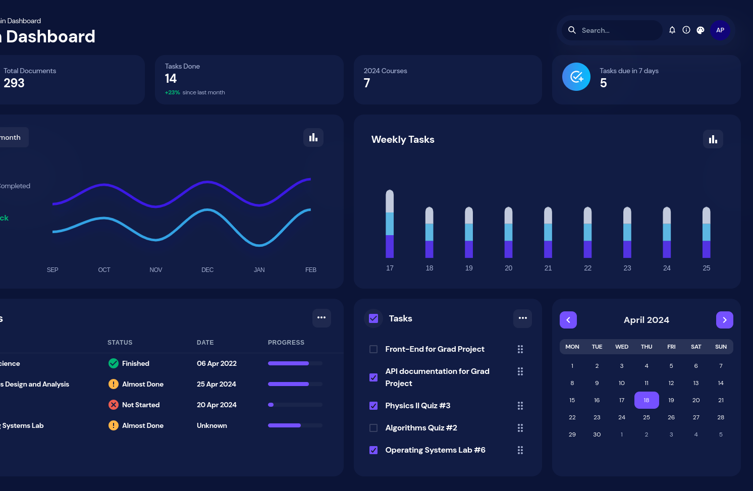
Dashboards
Dashboards for tasks, progress, and others.

Slide 13





Platform Entities
User
Course
Task
Resource
Notes:
Talk about each one in a bit more details and how some of them are stateless

Slide 14
Auto Generated ID
140 bits consisting of 128 bit for a UUID (v4) and 12 bit for the Entity Type
Notes:
Talk about why the 12 type bits are important used in Query Engine and analysis for policies

Slide 15



System Architecture Principles
Containers and Serverless Architecture
Well defined Interfaces
Operational work is minimal with low cost and high performance
Notes:
Serverless functions (not necessary a function for each thing but rather modules)
Don't communicate by sharing memory; share memory by communicating

Slide 16
System Communication
00.
01.
Communication is through Interfaces (APIs) or Message Brokers.
Verification and Authorization is done JWT.

Slide 17
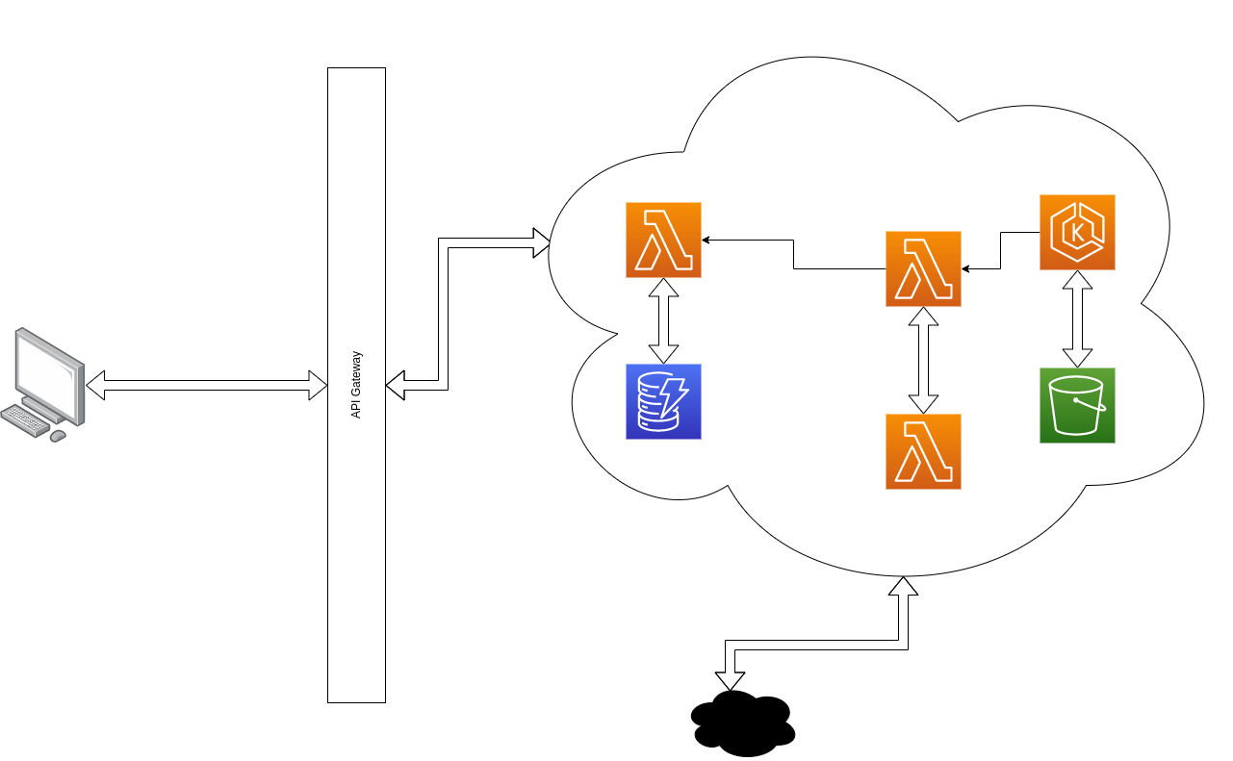
Big Picture
Notes:
Some services talk to each other, some don't, other are just to compute

Slide 18
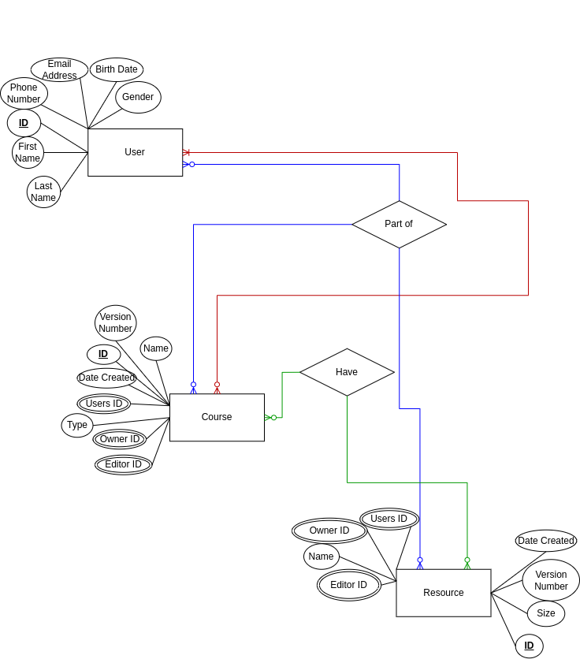
ER Diagram sample

Slide 19
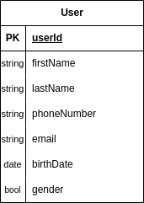
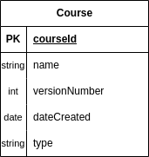
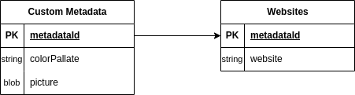
Database Design
Databases are logically connected through relationships, but physically disconnected for efficiency, reliability, data ownership, and isolation purposes.
Notes:
NoSQL databases are a good fit for microservices because they are designed to be flexible, scalable, and fault-tolerant
scale horizontally
improve the performance of microservices applications by reducing the amount of data that needs to be transferred between the application and the database

Slide 20
Thanks !

Slide 21

References

